Slide 1

^{Yüksek} Başarımlı (Paralel) Hesaplama
Kamer Kaya

Slide 2
Yüksek başarım?
1. (isim) Elde edilen bir başarı
2. Herhangi bir olayı veya durumu başarma isteği ve gücü
3. Kişinin yapabileceği en iyi derece, performans
4. Herhangi bir eseri, oyunu, işi vb.ni ortaya koyarken gösterilen başarı, performans

Slide 3
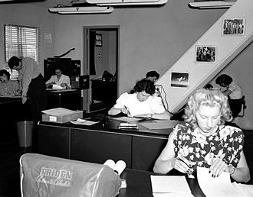
1800ler
"Computer" kelimesinin ilk defa New York Times gazetesinde gözüktüğü tarih: May 2, 1892; US Civil Service Commission tarafından verilen bir ilan:
"A Computer Wanted. [...] The examination will include the subjects of algebra, geometry, trigonometry, and astronomy."

Slide 4
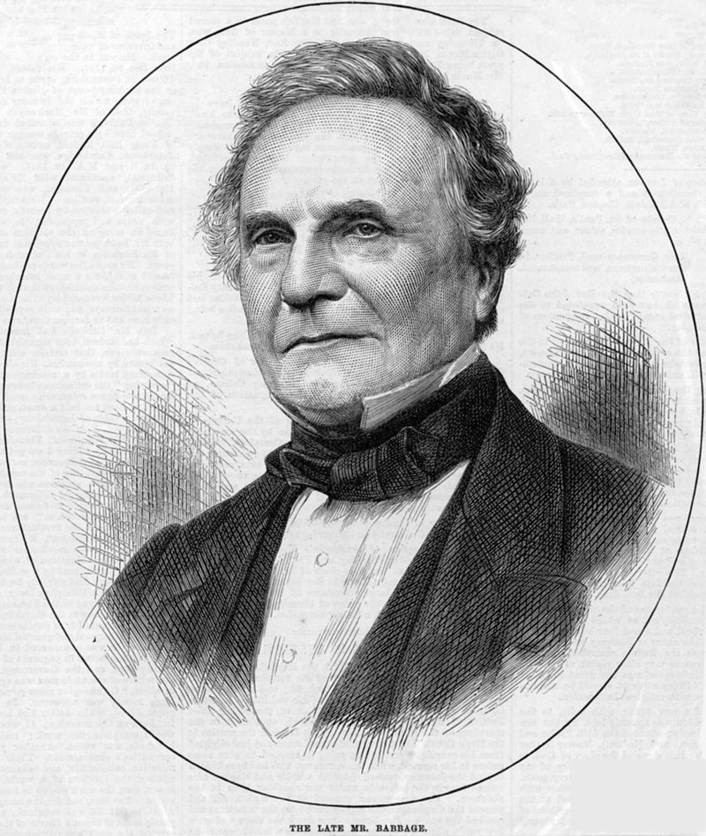
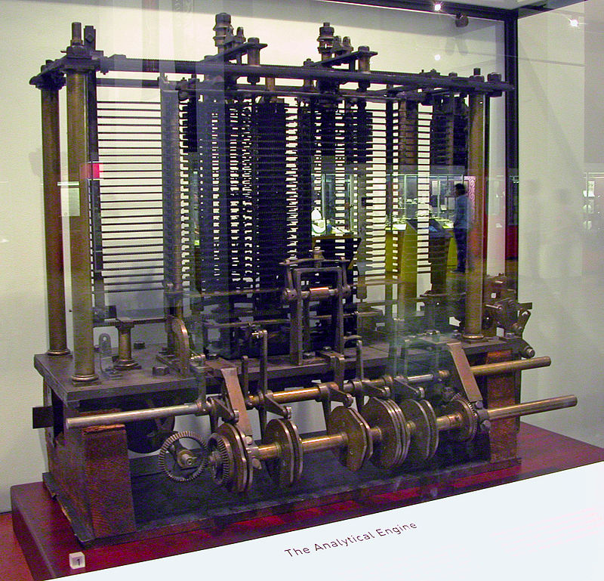
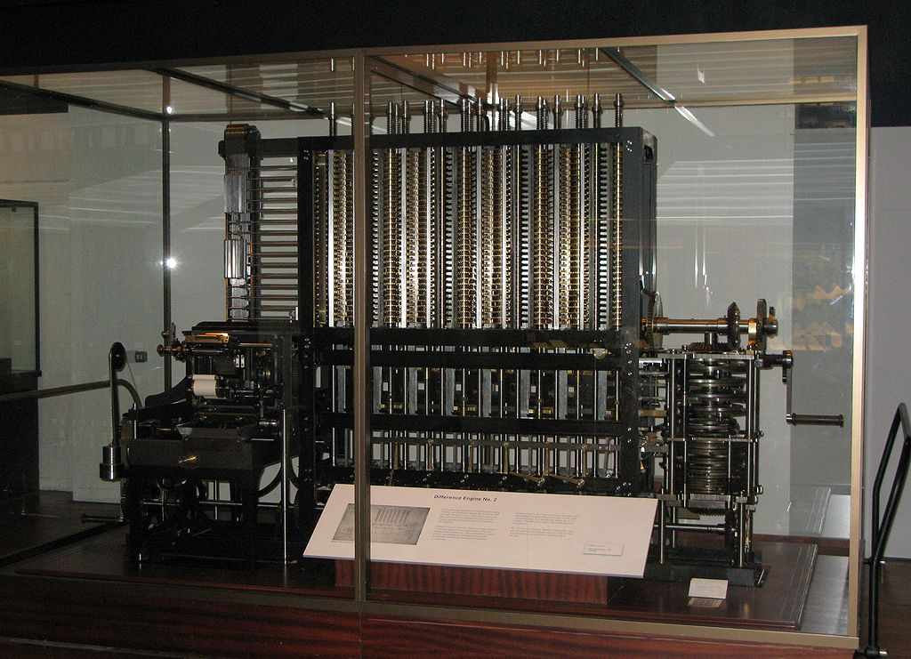
1800ler Charles Babbage
The Science Museum Difference Engine No. 2, Babbage’ın birebir tasarımı
Analytical Engine prototipi, The Science Museum

Slide 5
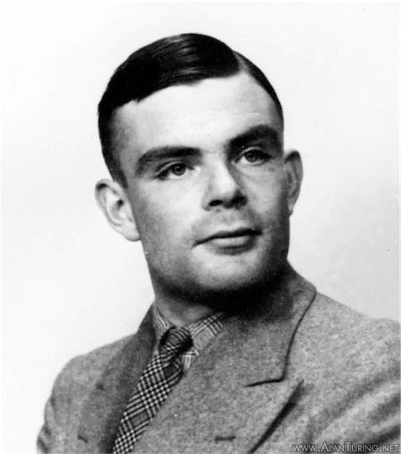
1930lar Alan Turing
1936
Notes:
a hypothetical machine can be constructed that can solve any solvable problem using simple rules (turing machine)
the enshaydang is unsolvable in the general case

Slide 6
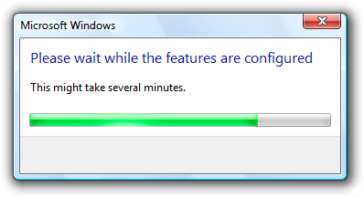
1930lar Alan Turing
Hesaplanabilirlik teorisinde, Durma problemi, keyfi bir bilgisayar programının ve girdinin açıklamasından, programın koşmayı bitirip bitirmeyeceğine ya da sonsuza dek koşmaya devam edip etmeyeceğine karar verme problemidir.
Büyük olasılıkla durmayacak bir program
Notes:
The halting problem is historically important because it was one of the first problems to be proved undecidable. (Turing's proof went to press in May 1936, whereas Alonzo Church's proof of the undecidability of a problem in the lambda calculus had already been published in April 1936 (Church, 1936).) Subsequently, many other undecidable problems have been described.

Slide 7
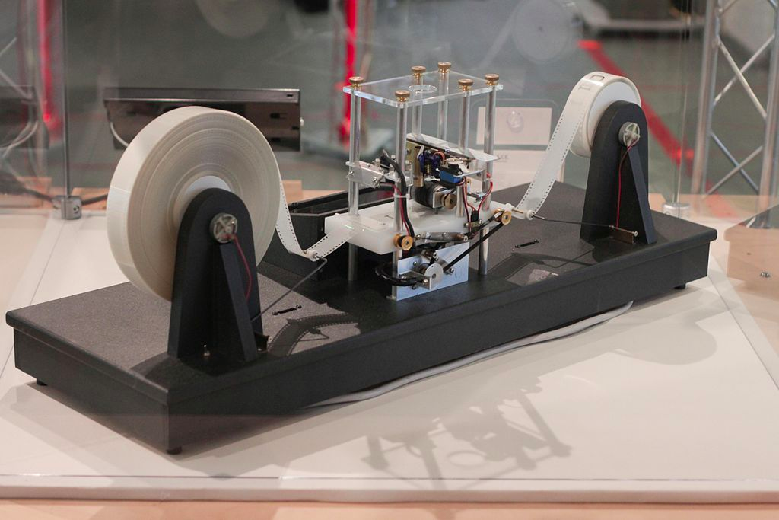
1930lar Alan Turing
Hesaplanabilirlik teorisinde, bir veri-manipülasyon kuralları sistemi (bir bilgisayarın komut kümesi, bir programlama dili veya hücresel bir otomat gibi) tek bir bantlı Turing makinesini simüle etmek için kullanılabiliyorsa, Turing tam veya hesaplamalı evrensel olduğu söylenir .
Bir Turing makinesi
Notes:
a hypothetical machine can be constructed that can solve any solvable problem using simple rules (turing machine)
the entscheidungsproblem is unsolvable in the general case

Slide 8
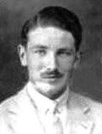
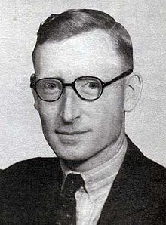
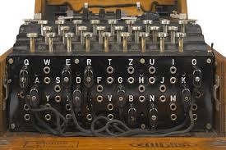
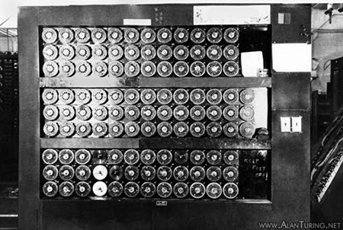
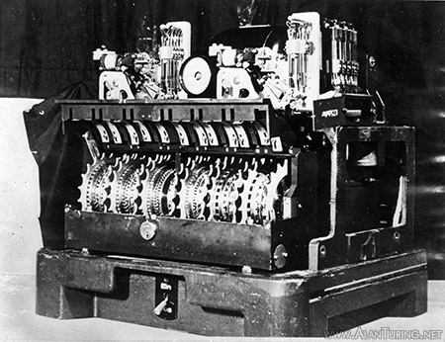
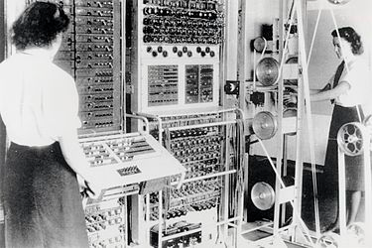
1939-1945 II. Dünya Savaşı
Turing
Welchman
Flowers
vs.
İYİ ADAMLAR
Enigma
Bombe
KÖTÜ ADAMLAR
vs.
A Lorenz Şifreleme Makinası
Colossus
Notes:
There is an interesting relation between Wars and Supercomputers
Not only WWII but also Cold War (nuclear weapon, aircrafts, submarines, code breaking etc.)
Lesson to learn: If we want Quantum Computing to take place sooner, we need a WWIII,
for sooner exascale computing another cold war (between China and USA) is enough
Alan Turing,
Gordon Welchman,
Tommy Flowers –
Uboat Enigma --- 150 million million million settings
Bombe name is given to honor the early work by Polish
Tunny Machine Lorenz Company - Nazi High Command
Colossus: first electronic digital computer

Slide 9
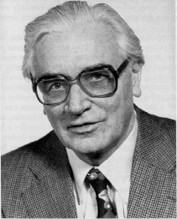
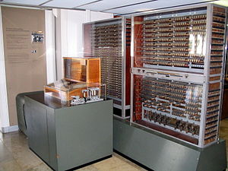
1936-38 1939-40 1941… Z1 Z2 Z3…
(TURING TAM)
Konrad Zuse
Ortalama hesaplama hızı: ek - 0.8 saniye, çarpma - 3 saniye
Aritmetik birim: İkili kayan noktalı, 22 bit, ekle, çıkart, çarp, böl, karekök
Veri belleği: 22 bit uzunluğa sahip 64 sözcük
Program hafızası: Delinmiş selüloit bant
Girdi: Ondalık kayan nokta sayıları
Frekans: 5.3 Hertz
Güç tüketimi: Yaklaşık 4.000 watt
Ağırlık: Yaklaşık 1 ton (2,200 lb)
Zuse Z3 replikası Deutsches Museum, Munich
Notes:
Konrad Zuse – German Alan Turing, or Alan Turing is the British Konrad Zuse
Engineer vs mathematician
The first fully operative automatic,
programm controlled and freely
programmable, in binary floating
point arithmetic working computer.
The Z3 was finished in 1941.

Slide 10
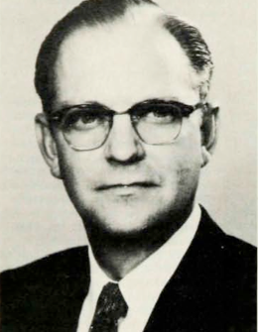
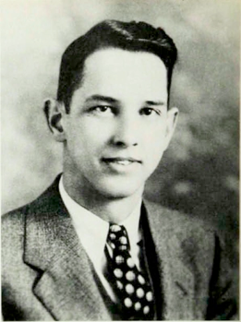
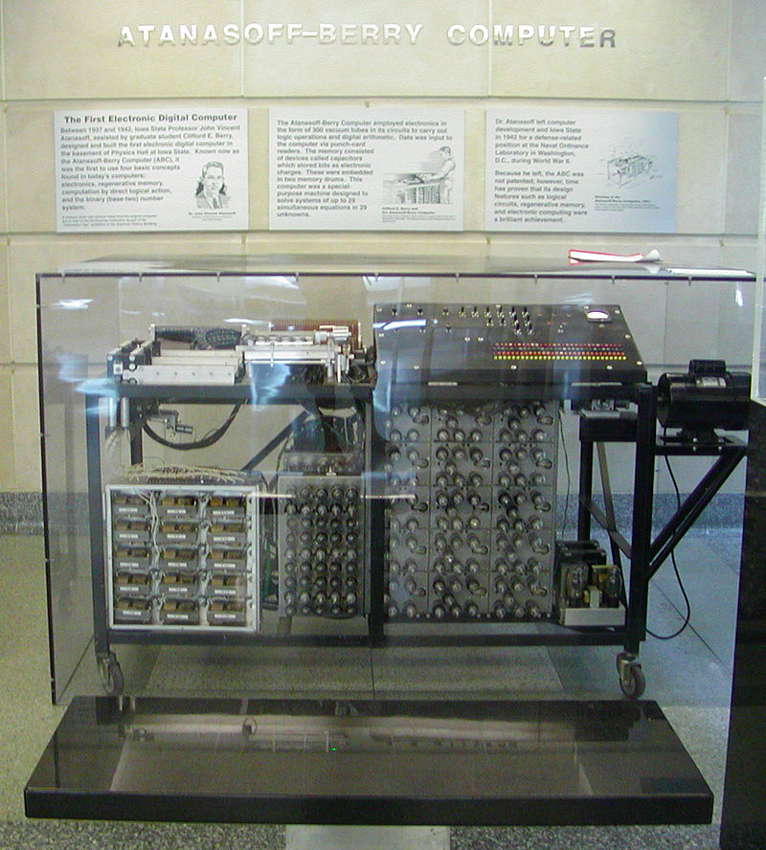
1939-42 Atanasoff-Berry Bilgisayarı(ABC)
Atanasoff
Berry
Üç önemli fikir:
Tüm sayıları ve verileri temsil etmek için ikili basamakları kullanma
Tüm hesaplamaları, tekerlekler, mandallar veya mekanik anahtarlar yerine elektronik kullanarak gerçekleştirmek
Hesaplama ve hafızanın ayrıldığı bir sistemi kullanmak.
Atanasoff–Berry bilgisayarı Durham Center, Iowa State University
Notes:
Not Turing complete
Linear algebra, solver, 29 unknowns
“Since an expert [human] computer takes about eight hours to solve a full set of eight equations in eight unknowns, k is about 1/64. To solve twenty equations in twenty unknowns should thus require 125 hours . . . The solution of general systems of linear equations with a number of unknowns greater than ten is not often attempted.”
John Vincent Atanasoff and his assistant, Clifford E. Berry

Slide 11
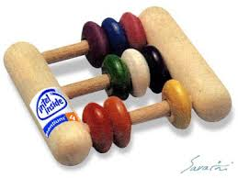

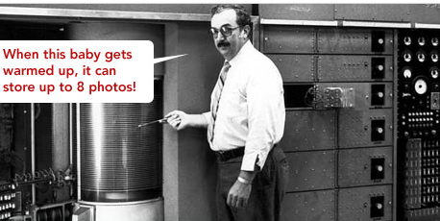
1945-1960s
IBM 5Mb HD (1956)
ENIAC (1945)

Slide 12
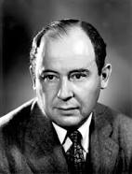
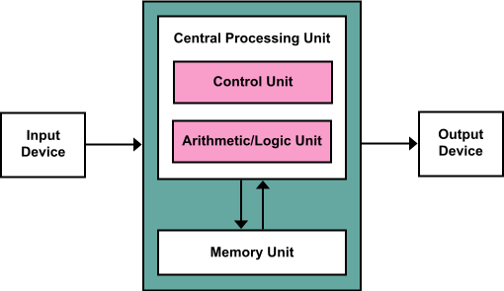
1945 Von Neumann Mimarisi
John von
Neumann
Notes:
Many contributions to math, game theory, set theory, linear programming, measure theory
Member of ENIAC team
First Draft of a Report on the EDVAC
so-called Von Neumann Architecture is centered on the following three characteristics: There are four principal components: a) memory, b) input/output (I/O), c) an arithmetic/logic unit (ALU), and d) a control unit (CU). The stored program concept. Instructions are executed sequentially
Stored program concept -> not von neumann, turing (1936) zuse (patent applications rejected around the same years)
There are four principal components: a) memory, b) input/output (I/O), c) an arithmetic/logic unit (ALU), and d) a control unit (CU).
Instructions are executed sequentially.

Slide 13

o zamanlar geleceği tahmin etmek oldukça güçtü
“Sanırım bütün dünyada sadece 5 bilgisayarlık bir pazar olacak’’
IBM başkanı, 1943

Slide 14
ama bazıları dğour tahmin edebilmişti
“Gelecekte bilgisayarların ağırlığı en fazla
1.5 ton
olacak.”
Popular Mechanics, 1949

Slide 15
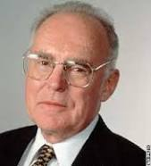
1965 Moore’s Law
Gordon Moore
1975: Yarı iletken karmaşıklığı, yaklaşık 1980 yılına kadar yıllık iki katına çıkmaya devam edecek ve bundan yaklaşık iki yılda bir iki katına çıkacaktı
Notes:
At the 1975 IEEE International Electron Devices Meeting, Moore revised the forecast rate.[6][33] Semiconductor complexity would continue to double annually until about 1980 after which it would decrease to a rate of doubling approximately every two years.[33] He outlined several contributing factors for this exponential behavior:[31][32]
die sizes were increasing at an exponential rate and as defective densities decreased, chip manufacturers could work with larger areas without losing reduction yields;
simultaneous evolution to finer minimum dimensions;
and what Moore called "circuit and device cleverness".

Slide 16
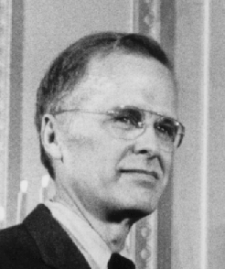
1977 von Neumann darboğazı
John Backus
Bir sistem darboğazı: Merkezi İşlemci Birimleri (CPU'lar) ve Rasgele Erişim Belleği arasındaki bant genişliği tipik bir CPU'nun dahili olarak veri işleyebileceği hızdan çok daha düşüktür.
Bir 'entelektüel darboğaz': programcılar CPU ve RAM arasında gidip gelen "bir sürü gerekli/gereksiz kelimeyi” azaltmak için gerekli kod optimizasyonlarını düşünmek için çok zaman harcıyorlar.
“… programming is basically planning and detailing the enormous traffic of words through the von Neumann bottleneck, and much of that traffic concerns not significant data itself, but where to find it.” [1977 Turing Award Lecture]
Notes:
Developer of Fortran
1977 ACM Turing Award:
Lecture -Can Programming be Liberated from the von Neumann Style?

Slide 17
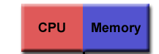
Bir işlemci

Slide 18
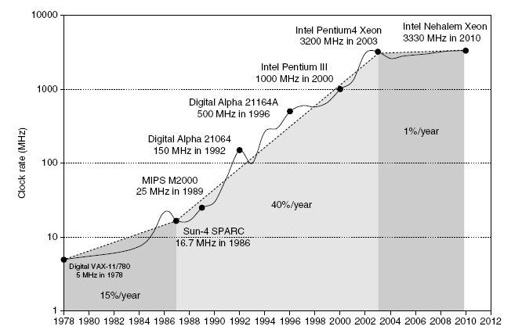

Bir zamanlar…

Slide 19
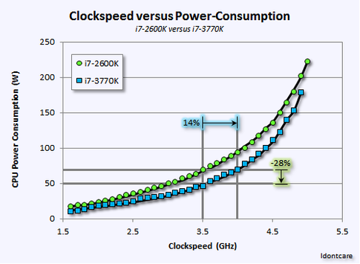
Güç duvarı

Slide 20
Hafıza duvarı
1000
“Moore Yasası”
CPU
100
İşlemci-Hafıza
Perfomans farkı: (yılda 50% artış)
Performans
10
DRAM
1
1980
1981
1982
1983
1984
1985
1986
1987
1988
1989
1990
1991
1992
1993
1994
1995
1996
1997
1998
1999
2000

Slide 21
Hafıza duvarını aşmak
CPU yazmaçları
100s Byte
300 – 500 ps (0.3-0.5 ns)
Yazmaç
Komut işlenenleri
derleyici
1-8 byte
L1 ve L2 önbelleği
10ns-100ns
$1000s/ GByte
L1 Önbellek
Blok
Önbellek yöneticisi
32-64 byte
L2 Önbellek
Önbellek yöneticisi
64-128 byte
G Bytes
80ns- 200ns
~$100/ GByte
Blok
Hafıza
Sayfa
İşletim sistemi
4K-8K byte
T Byte, 10 ms (10,000,000 ns)
~$1 / GByte
Disk
kullanıcı
Mbyte
Dosya
Sonsuz
saniye-dakika
~$1 / GByte
Kaset

Slide 22
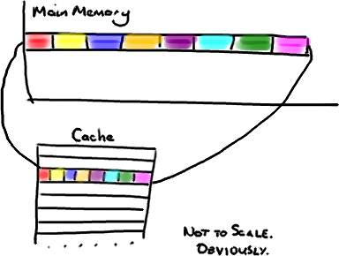
Önbellek: en iyi dostunuz
Trisha Gee

Slide 23
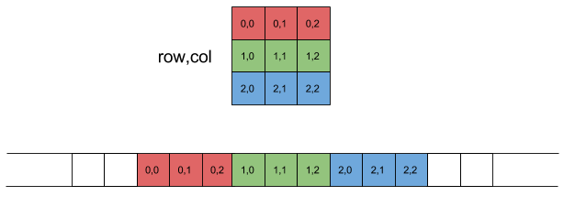
Matrislerin sütunlarının toplamı
satır, sütun
2d verilerin hafıza yapısı

Slide 24
Matrislerin sütunlarının toplamı
satır, sütun
1
2
3

Slide 25
Matrislerin sütunlarının toplamı
satır, sütun

Slide 26
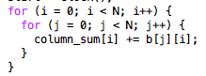
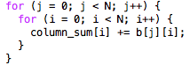
Matrislerin sütunlarının toplamı
2 saniye
0.1 saniye
20x daha hızlı
Notes:
perf stat -B -e cache-references,cache-misses,cycles,instructions,branches,faults,migrations ./a.out
Only the miss percentage can be misleading
Try this: perf stat -B -e cache-references,cache-misses,cycles,instructions,L1-dcache-loads,L1-dcache-misses,LLC-loads,LLC-load-misses

Slide 27
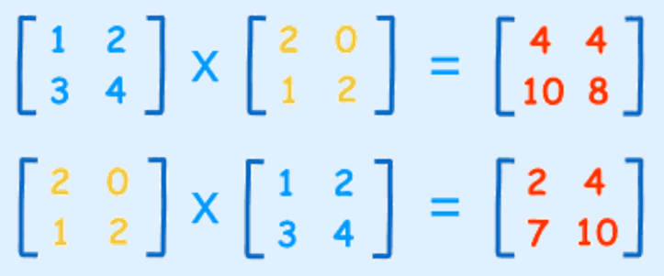
Matris Çarpımı
Trisha Gee

Slide 28
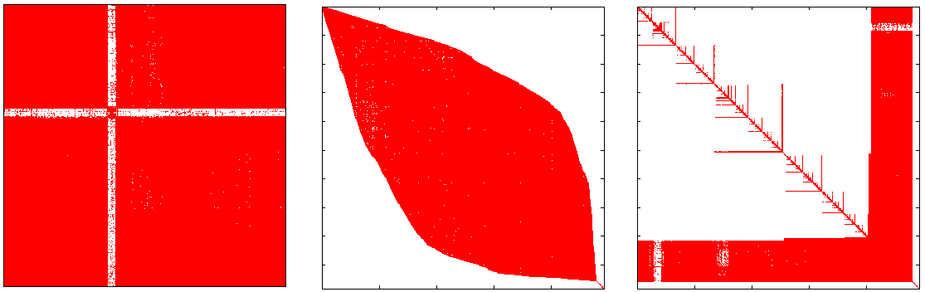
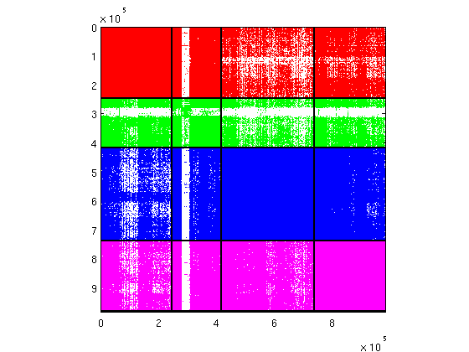
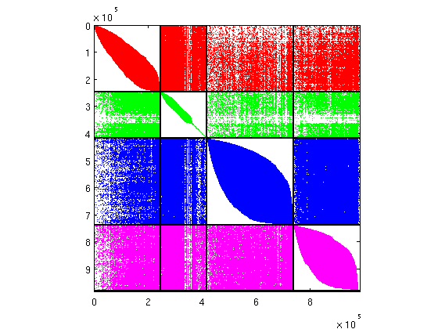
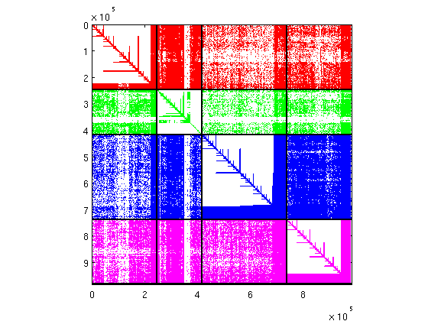
Matris sıralama

Slide 29
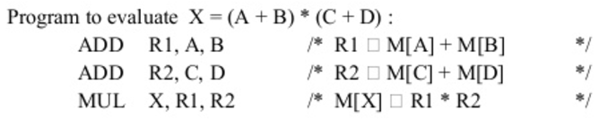
Komut seviyesinde koşutluk

Slide 30
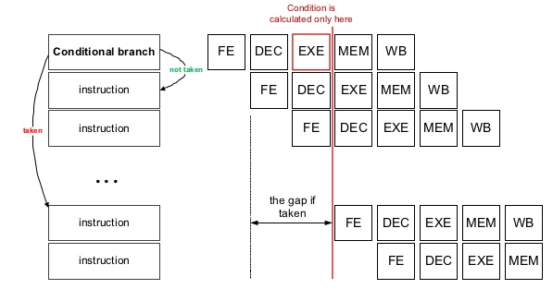
Komutlar: Düzenleme, yeniden sıralama vb.
Her zaman kodladığınız gibi çalışmıyor
Pipelining
Notes:
30 deep pipeline, Xeon

Slide 31
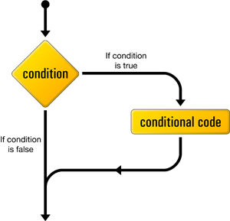
Komutlar: Düzenleme, yeniden sıralama vb.
Ne çalıştırmak istediğimizi bilmiyorsak
Notes:
30 deep pipeline, Xeon

Slide 32
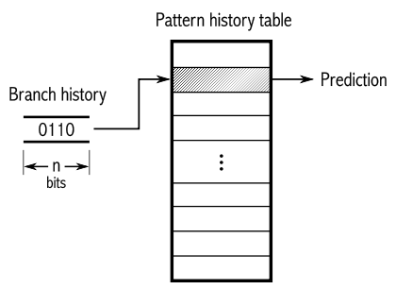
Komutlar: Düzenleme, yeniden sıralama vb.
Dal tahmincisi

Slide 33
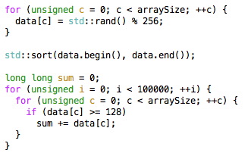

Komutlar: Düzenleme, yeniden sıralama vb.
13.2 saniye, 1.5 B yanlış tahmin
Notes:
Compiled with: g++ branch_prediction.cpp -O2
You can count stats by: perf stat ./a.out
For more perf examples see: http://www.brendangregg.com/perf.html

Slide 34
Komutlar: Düzenleme, yeniden sıralama vb.
2.1 saniye, 364 K yanlış tahmin
Notes:
Compiled with: g++ branch_prediction.cpp -O2
You can count stats by: perf stat ./a.out
For more perf examples see: http://www.brendangregg.com/perf.html

Slide 35
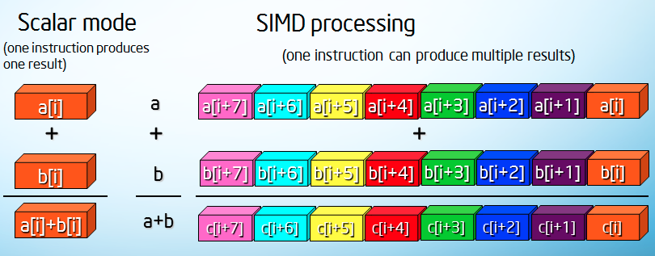
Komut seviyesinde koşutluk

Slide 36
Komut seviyesinde koşutluk: matris-vektör çarpımı örneği
Matris-vektör çarpımı
Notes:
Copmile with –mavx –O3

Slide 37
Hafıza duvarını aşmak
for (i = 0; i < N; i++) {
sum += a[i]*b[i];
}
Bu değil
Belki de bu
for (i = 0; i < N; i++){
fetch (&a[i+1]);
fetch (&b[i+1]);
sum += a[i]*b[i];
}

Slide 38
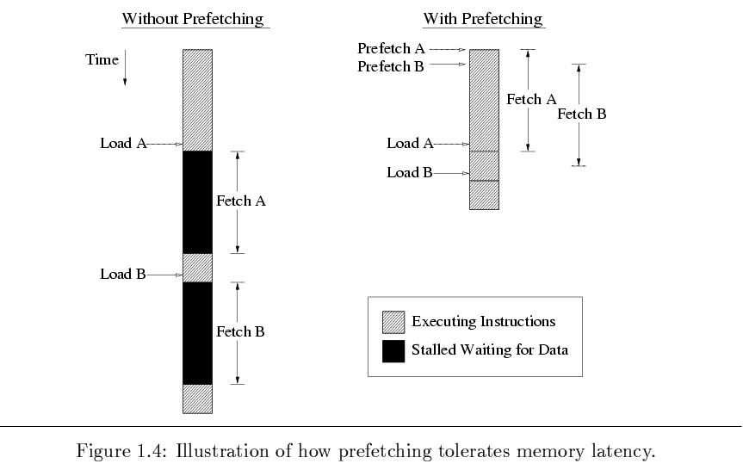
Hafıza duvarını aşmak

Slide 39
Hafıza duvarını aşmak
Quicksort example

Slide 40
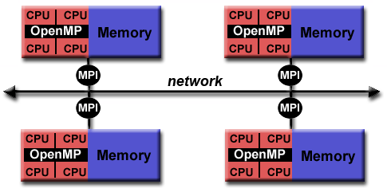
Bir işlemciden daha fazlası

Slide 41
Bugünün işlemcileri
Intel E7-8894v4
Frekans: 2.4 GHz
14nm
Çekirdek: 24
Hafıza: 3.07TB / soket
Hafıza veriyolu: 85 GBs
60 MB önbellek

Slide 42
Paralel (Koşut) İşlemler
Aynı anda birden fazla işlemin işlemci tarafından gerçekleştirilmesi.
Problem
Pr
ob
l
em

Slide 43
Birden fazla işlemci ve hızlanma
Bir problemi tek işlemci ile T(1) zamanda çözelim.
Aynı problem p işlemci ile T(p) zamanında çözülsün.
Hızlanma oranı T(1) / T(p)’dir.

Slide 44
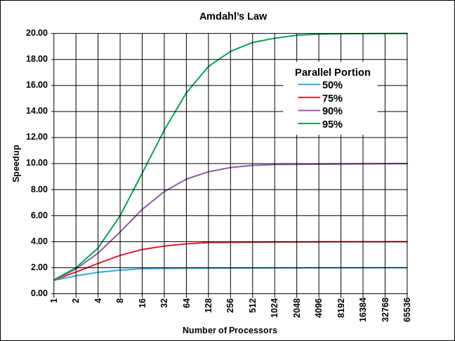
Amdahl Kuralı

Slide 45
Aykırı bir problem

Slide 46
Aykırı bir problem

Slide 47
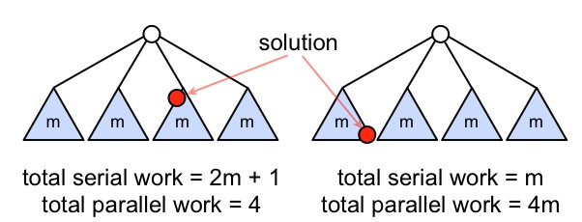
Aykırı bir problem

Slide 48
Çok çekirdekli işlemcileri programlama: OpenMP

Slide 49
Çok çekirdekli işlemcileri programlama: OpenMP

Slide 50
Çok çekirdekli işlemcileri programlama: OpenMP
PARALEL PROGRAMLAMA 101
x = 0
iplik 1
iplik 2
x = x + 1
x = x + 1

Slide 51
OpenMP: vektör çarpımı
double sum = 0.0;
double sum_local[NUM_THREADS];
#pragma omp parallel num_threads(NUM_THREADS)
{
int me = omp_get_thread_num();
sum_local[me] = 0.0;
#pragma omp for
for (i = 0; i < N; i++)
sum_local[me] += x[i] * y[i];
#pragma omp atomic
sum += sum_local[me];
}

Slide 52
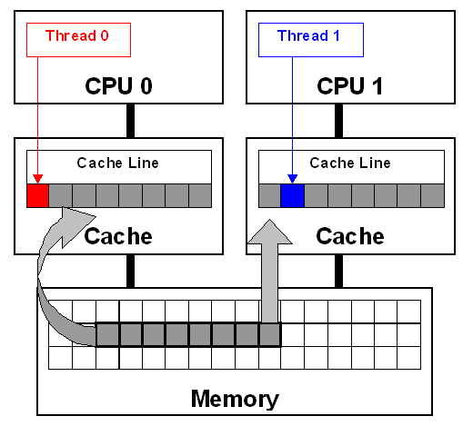
OpenMP

Slide 53
OpenMP: vektör çarpımı
double sum = 0.0;
double sum_local[NUM_THREADS][16];
#pragma omp parallel num_threads(NUM_THREADS)
{
int me = omp_get_thread_num();
sum_local[me][0] = 0.0;
#pragma omp for
for (i = 0; i < N; i++)
sum_local[me] += x[i] * y[i];
#pragma omp atomic
sum += sum_local[me][0];
}

Slide 54
OpenMP

Slide 55
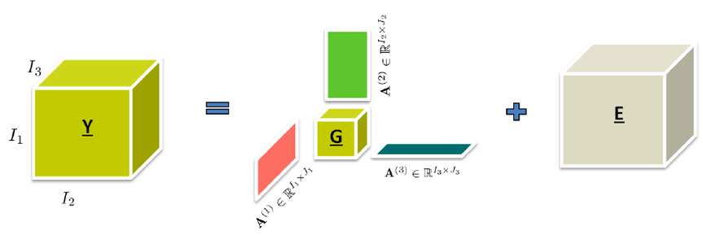
Örnek problem: Tensör ayrıştırma

Slide 56
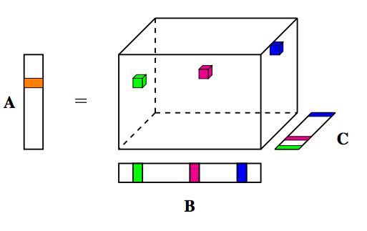
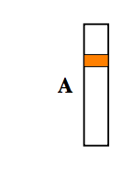
Örnek problem: Koşut tensör ayrıştırma

Slide 57
Örnek problem: Koşut tensör ayrıştırma

Slide 58

Çizge boyama problemi

Slide 59
Hiperçizge ile modelleme

Slide 60
Hiperçizge boyama

Slide 61
Hiperçizge modelleme/boyama

Slide 62

Koşut tensör ayrıştırma

Slide 63


Koşut tensör ayrıştırma

Slide 64

Tensör depolama

Slide 65
Tensör sıralama?

Slide 66

Bir bilgisayar

Slide 67
Bir bilgisayardan daha fazlası

Slide 68

Bir bilgisayardan daha fazlası

Slide 69

Bir bilgisayardan çok daha fazlası
1,024 işlemci
59.7 gigaflop/s
M-5: LOS ALAMOS NATIONAL LAB
No 1. süperbilgisayar, Haziran1993

Slide 70

Bir bilgisayardan çoooook daha fazlası
478.2 Teraflop/s
BLUEGENE/L: LAWRENCE LIVERMORE NATIONAL LABORATORY, No 1. süperbilgisayar, 2004-2007

Slide 71

Neredeyse en süper bilgisayar
33.86 Petaflop/s (san. kuadrilyon işlem)
3,120,000 çekirdek
Intel Xeon Phi
TIANHE-2 (MILKYWAY-2) : NATIONAL UNIVERSITY OF DEFENSE TECHNOLOGY

Slide 72

En süper bilgisayar
SUNWAY TAIHULIGHT – 125 Petaflop/s
NATIONAL SUPERCOMPUTING CENTER IN WUXI
Araştırma geliştirme amaçlı
Meteoroloji,
Derin öğrenme,
Imalat ve malzeme bilimleri,
Veril analizi
Notes:
TaihuLight is currently up and running at the National Supercomputing Center in the city of Wuxi, a manufacturing and technology hub, a two-hour drive west of Shanghai. The system will be used for various.
The supercomputer was developed by the National Research Center of Parallel Computer Engineering & Technology (NRCPC), the same organization that designed TaihuLight’s predecessor, the Sunway BlueLight system, which is installed at the National Supercomputing Center in Jinan. BlueLight is a 796-teraflop supercomputer, which was deployed in 2011. It currently resides at number xx on the TOP500 list.
BlueLight is powered by an older version of the ShenWei processor, a third-generation 16-core chip, known as the SW1600, which tops out at about 140 gigaflops. In the five years since that system came online, NRCPC developed a much more powerful processor, the SW26010, a 260-core chip that can crank out just over 3 teraflops. TaihuLight has a single SW26010 in each of its 40,960 nodes, which adds up 125 peak petaflops across the entire machine (more than 10 million cores). Linpack, of course, is going to leave some FLOPS on the table, but 93 petaflops represents a respectable 74 percent yield of peak performance.

Slide 73





En süper 500 bilgisayar: Ülkeler
2013
2014
Number
Performance
Notes:
199 america, the fewest since 1993
234 2014

Slide 74




En süper 500 bilgisayar: Ülkeler
2015
2016
Number
Performance
Notes:
199 america, the fewest since 1993
234 2014

Slide 75

HPC Yatırımları

Slide 76

Süperbilgisayar trendleri
S. Anthony

Slide 77
Exascale: Kilo, Mega, Giga, Tera, Peta, Exa.
Saniye başına işlem sayısı (FLOPS, TEPS, …)
Terascale: 10¹², 1,000,000,000,000
Petascale: 10¹⁵, 1,000,000,000,000,000
Exascale: 10¹⁸, 1,000,000,000,000,000,000

Slide 78
Exascale: Kilo, Mega, Giga, Tera, Peta, Exa.

Slide 79
Exascale: Kilo, Mega, Giga, Tera, Peta, Exa.
Exascale hesaplama Yüksek Başarımlı Hesaplama alanının şu andaki en önemli hedeflerinden birisidir
Başlangıç: 2008/USA, 2011/Europe
Hedef: America, 2021-2023, China önümüzdeki yıl (gerçek?)

Slide 80


HPC’de geçen ay
Notes:
Intel® Omni-Path Architecture (Intel® OPA) is well suited to the demands of deep learning, enabling near-linear scalability across large numbers of nodes to provide fast time to results for large problems (see Figure 1).
Intel® Xeon® Scalable processors provide up to 2.2X higher neural network training performance than previous-generation Intel Xeon processors.[i]

Slide 81

HPC’de geçen ay
Notes:
September 22, 2017
The 66th HPC User Forum held September 5-7, in Milwaukee, Wisconsin, at the elegant and historic Pfister Hotel, highlighting the 1893 Victorian décor and art of “The Grand Hotel Of The West,” contrasted nicely with presentations on the latest trends in modern computing – deep learning, machine learning and AI.
Over the course of two days of presentations, a couple common themes became obvious: First, that machine and deep learning are focused currently on specific rather than general use cases and second, that ML and DL need to be part of an integrated workflow to be effective.
This was exemplified by Dr. Maarten Sierhuis from Nissan Research Facility Silicon Valley with his presentation “Technologies for Making Self-Driving Vehicles the Norm.” One of the most engaging talks, Dr. Sierhuis’s multi-media presentation on the triumphs and challenges facing Nissan while developing its self-driving vehicle program showcased that machine and deep learning “drives” the autonomous vehicle revolution.
The challenge that Nissan and other deep learning practitioners face is that current deep learning algorithms are programmed to learn to do one thing extremely well – the specific use case: image recognition of stop signs for example. Once an algorithm learns to recognize stop signs, the same amount of discrete learning must apply for every other road sign a vehicle may encounter. To create a general-purpose “road sign learning algorithm”, not only do you need a massive amount of image data (in the tens of millions of varied images), but also the compute to power the learning effort.
Dr. Weng-Keen Wong from the NSF echoed much the same distinction between the specific and general case algorithm during his talk “Research in Deep Learning: A Perspective From NSF” and was also mentioned by Nvidia’s Dale Southard during the disruptive technology panel. Arno Kolster from Providentia Worldwide in his presentation “Machine and Deep Learning: Practical Deployments and Best Practices for the Next Two Years” claimed as well that general purpose learning algorithms are obviously the way to go, but are still some time out.
Nissans’s Dr. Sierhuis went on to highlight some challenges computers still face which human drivers take for granted. For example, what does an autonomous vehicle do when a road crew is blocking the road in front of it? As a human driver, we’d simply move into the opposite lane to “just go around”, but to algorithms, this breaks all the rules: Crossing a double line, checking the opposite lane for oncoming traffic, shoulder checking, ensuring no crossing pedestrians, etc. All need real-time re-programming for the encountering vehicle and other vehicles that arriving at the obstacle.
Nissan proposes an “FAA-like” control system, but the viability of such a system remains to be seen. Certainly, autonomous technologies are integrating slowly into new cars to augment human drivers but a complete self-driving vehicle won’t appear in the marketplace overnight -cars will continue to function in a hybrid mode for some time. Rest assured, many of today’s young folks likely will never learn how to drive (or ask their parents to borrow the car on Saturday night).
This algorithmic specificity spotlights the difficulty of integrating deep learning into an actual production workflow.
Tim Barr’s (Cray) “Perspectives on HPC-Enabled AI” showed how Cray’s HPC technologies can be leveraged for Machine and Deep Learning for vision, speech and language. Stating that it all starts with analytics, Mr. Barr illustrated how industries such as Daimler improve manufacturing processes and products by leveraging deep learning to curtail vehicle noise and reduce vibration in its newest vehicles. Nikunj Oza from NASA Ames gave examples of machine learning behind aviation safety and astronaut health maintenance in “NASA Perspective on Deep Learning.” Dr. Oza’s background in analytics brought a fresh perspective to the proceedings and showcased that machine learning from history has earned a real place alongside modeling for industrial best practices.
In the simulation space, a fascinating talk from the LLNL HPC4Mfg program was William Elmer’s (LLNL) discussion of Proctor & Gamble’s “Faster Turnaround for Multiscale Models of Paper Fiber Products.” Simulating various paper product textures and fibers greatly reduce the amount of energy from drying and compaction. Likewise, Shiloh Industries’ Hal Gerber described “High Pressure Casting for Structural Requirements and The Implications on Simulation.” Shiloh’s team leverages HPC for changing vehicle structure — especially in creating lighter components with composites like carbon fiber and mixed materials.
It’s clear from the discussion that machine learning and AI are set to be first class citizens alongside traditional simulation within the HPC community in short order. While still unproven and with a wide variety of new software implementations, HP Labs presented a first-of-its-kind analysis of ML benchmarking on HPC Platforms. Hewlett Packard Labs’ Natalia Vassilieva’s “Characterization and Benchmarking of Deep Learning” showcased the “Book of Recipes” HP Labs is developing with various hardware and software configurations. Fresh off their integration of SGI technology into their technology stack, the talk not only highlighted the newer software platforms which the learning systems leverage, but demonstrated that HPE’s portfolio of systems and experience in both HPC and hyper scale environments is impressive indeed.
Graham Anthony, CFO of BioVista spoke on the “Pursuit of Sustainable Healthcare Through Personalized Medicine With HPC.” Mr. Anthony was very passionate about the work BioVista is doing with HPE and how HPC and deep learning change the costs of healthcare by increased precision in treatment through deriving better insights from data. BioVista takes insight from deep learning and feeds that into simulations for better treatments – a true illustration that learning is here to stay, and works hand in hand with business process flows for traditional HPC.
In his talk entitled “Charliecloud: Containers are Good for More Than Serving Cat Pictures?” Reid Priedhorsky from LANL covered a wide range of topics including software stacks, design philosophy and demoed Charliecloud which enables execution of docker containers on supercomputers.
The tongue-in-cheek title about cat pictures being synonymous with deep learning image recognition is not by accident. Stand-alone image recognition is really cool, but as expounded upon above, the true benefit from deep learning is having an integrated workflow where data sources are ingested by a general purpose deep learning platform with outcomes that benefit business, industry and academia.
From the talks, it is also clear that Machine Learning, Deep Learning and AI are presently fueled more by industry than by academia. This could be due to strategic and competitive business drivers as well as the sheer amount of data that companies like Facebook, Baidu and Google have available to them driving AI research and deep learning-backed products. HPC might not be needed to push these disciplines forward and is likely why we see this trend becoming more prevalent in everyday news.
There was obvious concern from the audience about a future where machines rule the world. Ethical questions of companies knowingly replacing workers with robots or AI came up in a very lively discussion. Some argued that there is a place for both humans and AI — quieting the fear that tens of thousands of people would be replaced by algorithms and robots. Others see a more dismal human future with evil and malevolent robots taking control and little left for humans to do. These are, of course, difficult questions to answer and further debates will engage and entertain everyone as we keep moving toward an uncertain, technical future.
On a lighter note, Wednesday evening’s dinner featured a local volunteer docent, Dave Fehlauer, giving an enjoyable, informative talk on Captain Frederick Pabst: his family, his world and his well-known Milwaukee staple, The Pabst Brewing Company.
By all accounts, this was one of the most enjoyed HPC User Forums meetings. With a coherent theme and a dynamic range of presentations, the Forum kept everyone’s interest and showcased the realm of possibilities within this encouraging trend of computing, both from industry and academic research perspectives.
The next domestic HPC User Forum will be held April 16-18, 2018 at the Loews Ventana Canyon in Tucson, Arizona. See http://hpcuserforum.com for further information.

Slide 82

HPC’de geçen ay

Slide 83

HPC’de geçen ay
The cool, temperate climate in Iceland enables free cooling, that when combined with the low-cost, renewable power, means that companies can save more than 70% on the total cost of operations for their compute resources over less optimal locations within the US, UK and continental Europe. The combination of innovative, technical design and an optimal location make Verne Global one of the worlds most efficient data center campuses.
Notes:
LONDON & KEFLAVIK, Iceland, Sept. 20, 2017 — Verne Global, a provider of highly optimised, secure, and 100% renewably powered data center solutions, today announced that DeepL has deployed its 5.1 petaFLOPS supercomputer in its campus. Designed to support DeepL’s artificial intelligence (AI) driven, neural network translation service, this supercomputer is viewed by many as the world’s most accurate and natural-sounding machine translation service. Verne Global was selected because of the following factors:
The innovative campus design specialised to support HPC and other intensive compute environments driven by the rise in AI, machine learning and big data analytics
The expertise and technical knowledge of the Verne Global team, and
Verne Global’s access to Iceland’s abundant, renewable power and its highly reliable, low-cost energy grid.
“For DeepL, we needed a data center optimised for high-performance computing (HPC) environments and determined that our needs could not be met in Germany. Verne Global’s Icelandic campus provides us with the scalability, flexibility and technical resources we need. In addition, the abundance of low-cost renewable energy and free cooling will allow us to train DeepL’s neural networks at lower cost and faster scalability,” says Jaroslaw Kutylowski, CTO of DeepL. “Verne Global’s team has a high level of technical expertise, which helps us to implement ad hoc requests quickly and easily. I’ve never seen such an excellent cooperation before.”
On the supercomputer located within Verne Global’s campus, DeepL trains the neuronal translation networks based on collected data sets. As DeepL learns, the network leverages AI to examine millions of translations and learn independently how to translate with the right grammar and structure.
“We are pleased that our HPC-optimised campus was the ideal location for DeepL’s supercomputer. Our location in Iceland provides a low and stable energy price with the highest possible availability and scalability – criteria that are indispensable for computational and power-intensive applications,” says Tate Cantrell, Chief Technology Officer of Verne Global. “We are seeing growing interest from companies using AI tools, such as deep neural network (DNN) applications, to revolutionise how they move their businesses forward, create change, and elevate how we work, live and communicate.”
The market for AI, machine learning and cognitive computing is expanding rapidly. According to a recent paper, “Artificial Intelligence, The Next Digital Frontier?”, issued by the McKinsey Global Institute, the total annual external investment in AI was between $8B to $12B in 2016, with machine learning attracting nearly 60% of that investment. McKinsey also states that, “A confluence of developments is driving this new wave of AI development. Computer power is growing, algorithms and AI models are becoming more sophisticated, and, perhaps most important of all, the world is generating once unimaginable volumes of the fuel that powers AI—data. Billions of gigabytes every day, collected by networked devices ranging from web browsers to turbine sensors.”
Verne Global’s data center, located on a former NATO base in Iceland, draws its electricity from hydroelectric and geothermal energy. The cool, temperate climate in Iceland enables free cooling, that when combined with the low-cost, renewable power, means that companies can save more than 70% on the total cost of operations for their compute resources over less optimal locations within the US, UK and continental Europe. The combination of innovative, technical design and an optimal location make Verne Global one of the worlds most efficient data center campuses.

Slide 84

Veri alışverişi

Slide 85
Ağ topolojileri

Slide 86
Ağ topolojileri

Slide 87
Örnek problem: bir mesajı her yere gönderme

Slide 88
Örnek problem: bir mesajı her yere gönderme

Slide 89
Örnek problem: mesajları bir yerde toplama

Slide 90


Neden veri gönderiyoruz?

Slide 91

Neden veri gönderiyoruz?

Slide 92
Neden veri gönderiyoruz?

Slide 93
MPI

Slide 94
MPI

Slide 95
MPI: herkes bir sonraki işlemciye mesaj gönderirse

Slide 96
MPI: herkes bir sonraki işlemciye mesaj gönderirse

Slide 97

Matrisler ve (Hiper)çizgeler

Slide 98
Örnek problem: SpMV

Slide 99
Örnek problem: SpMV
Kapasite metrikleri
Gönderilen
Alınan Byte
Toplam
Hız metrikleri
Gönderilen
Alınan Mesaj
Toplam

Slide 100
Örnek problem: SpMV

Slide 101

Grafik İşleme Üniteleri

Slide 102

Grafik İşleme Üniteleri

Slide 103


(Basitçe) GİÜ kullanımı
PCI Bus
1- Veriyi işlemci tarafından GİÜ tarafına taşı

Slide 104
(Basitçe) GİÜ kullanımı
PCI Bus
2- GİÜ programını çalıştır (önbelleği mümkün olduğu kadar kullan).

Slide 105
(Basitçe) GİÜ kullanımı
PCI Bus
3- Sonuçları geri al.

Slide 106
GİÜ: Özellikler
Öznitelikler | Tesla K80 | Tesla K40
GPU | 2x Kepler GK210 | 1 Kepler GK110B
Peak double precision float. | 2.91 Tflops (GPU Boost Clocks) | 1.66 Tflops (GPU Boost Clocks)
point performance | 1.87 Tflops (Base Clocks) | 1.43 Tflops (Base Clocks)
Peak single precision float. | 8.74 Tflops (GPU Boost Clocks) | 5 Tflops (GPU Boost Clocks)
point performance | 5.6 Tflops (Base Clocks) | 4.29 Tflops (Base Clocks)
Memory bwidth (ECC off)² | 480 GB/sec (240 GB/sec per GPU) | 288 GB/sec
Memory size (GDDR5) | 24 GB (12GB per GPU) | 12 GB
CUDA cores | 4992 (2496 per GPU) | 2880

Slide 107


Grafik İşleme Üniteleri
NVIDIA TESLA P100
7000$

Slide 108



Grafik İşleme Üniteleri

Slide 109
GİÜ: Programlama - CUDA
__global__
void hello(char *a, int *b) {
a[threadIdx.x] += b[threadIdx.x];
}

Slide 110
GİÜ: Programlama - CUDA
cudaMalloc( (void**)&bd, isize );
cudaMemcpy( ad, a, csize,cudaMemcpyHostToDevice );
cudaMemcpy( bd, b, isize, cudaMemcpyHostToDevice );
dim3 dimBlock( blocksize, 1 );
dim3 dimGrid( 1, 1 );
hello<<<dimGrid, dimBlock>>>(ad, bd);
cudaMemcpy(a, ad, csize, cudaMemcpyDeviceToHost );
cudaFree( ad );
cudaFree( bd );

Slide 111
GİÜ: Programlama – CUDA Kernel

Slide 112

GİÜ: Programlama – CUDA Kernelden Bloklara

Slide 113

GİÜ: Programlama – CUDA Bloklardan Warplara

Slide 114
GİÜ: Programlama – CUDA Bloklardan Warplara
En önemli üç nokta
Warp içinde dallanan kodlar olmamalı
Warp içindeki ipliklere eşit yük paylaşımı
Warp içindeki ipliklerin kompakt hafıza erişimi

Slide 115
GİÜ: Programlama – CUDA Bloklardan Warplara

Slide 116
GİÜ: Programlama – CUDA Bloklardan Warplara
Hangisi bantgenişliğini daha verimli kullanır?

Slide 117
Örnek program: switch
int a = threadID.x;
switch(a) {
case(1): doA();
case(2): doB();
case(3): doC();
case(4): doD();
case(5): doE();
case(6): doF();
case(7): doG();
case(8): doH();
}

Slide 118
Örnek problem: PageRank, BFS vs.

Slide 119
Örnek problem: PageRank, BFS vs.

Slide 120
Örnek problem: PageRank, BFS vs.

Slide 121
Örnek problem: PageRank, BFS vs.

Slide 122
Örnek problem: Merkezi noktaları bulmak

Slide 123
GİÜ: Programlama – CUDA Hafıza yapısı

Slide 124
GİÜ: Programlama – CUDA Hafıza yapısı

Slide 125
GİÜ: Programlama – CUDA Hafıza yapısı

Slide 126
GİÜ: Programlama – CUDA Hafıza yapısı

Slide 127


Slide 128


Slide 129


Slide 130


Slide 132


Slide 133


Slide 134


Slide 135
Örnek problem: 1D-stencil
Tek boyutlu dizinde
Her çıktı elemanı belli bir yarıçaptaki girdi elemanlarının toplamına eşit
girdi
çıktı
yarıçap
yarıçap
girdi
çıktı

Slide 136
Örnek problem: 1D-stencil
__global__ void stencil_1d(int *in, int *out) {
int i = threadIdx.x + blockIdx.x * blockDim.x;
for (int offset = -R; offset <= R; offset++)
out[i] += in[i + offset];
}

Slide 137
Örnek problem: 1D-stencil
__global__ void stencil_1d(int *in, int *out) {
int i = threadIdx.x + blockIdx.x * blockDim.x;
int result = 0;
for (int offset = -R; offset <= R; offset++)
result += in[i + offset];
out[i] = result;
}

Slide 138
Örnek problem: 1D-stencil
__global__ void stencil_1d(int *in, int *out) {
__shared__ int temp[BLOCK_SIZE + 2 * RADIUS];
int gindex = threadIdx.x + blockIdx.x * blockDim.x;
int lindex = threadIdx.x + RADIUS;
// Read input elements into shared memory
temp[lindex] = in[gindex];
if (threadIdx.x < RADIUS) {
temp[lindex - RADIUS] = in[gindex - RADIUS];
temp[lindex + BLOCK_SIZE] =
in[gindex + BLOCK_SIZE];
}

Slide 139

Örnek problem: 1D-stencil
// Apply the stencil
int result = 0;
for (int o = -RADIUS ; o <= RADIUS ; o++)
result += temp[lindex + o];
// Store the result
out[gindex] = result;
}

Slide 140
İsviçre Çakıları…
Tek kod. Bütün işlemciler ve hızlandırıcılar
OpenMP 5.0, OpenACC, OpenCL

Slide 141
İsviçre Çakıları…
OpenMP to Intel Xeon Phi
#pragma omp target device(0) map(tofrom:B)
#pragma omp parallel for
for (i=0; i<N; i++)
B[i] += sin(B[i]);

Slide 142
İsviçre Çakıları…
OpenMP to GPGPU
#pragma omp target device(0) map(tofrom:B)
#pragma omp teams num_teams(num_blocks)
num_threads(bsize)
#pragma omp distribute
for (i=0; i<N; i += num_blocks)
#pragma omp parallel for
for (b = i; b < i+num_blocks; b++)
B[b] += sin(B[b]);

Slide 143
İsviçre Çakıları…
OpenACC to GPGPU
#pragma acc parallel copy(B[0:N]) \ num_gangs(numblocks) \
vector_length(bsize)
#pragma acc loop gang vector
for (i=0; i<N; ++i) {
B[i] += sin(B[i]);
}

Slide 144
İsviçre Çakıları

Slide 145


İsviçre Çakıları

Slide 146
Python ile basitçe paralel programlama
Çok çekirdekli işlemciler…
Birden fazla iplik kullanımı (OpenMP, CUDA vb.)
Fakay python’da bu çok verimli olmuyor
Global Interpreter Lock
Güvenli çok çekirdekli işleme

Slide 147
Python ile basitçe paralel programlama
Python’un multiprocessing kütüphanesinin bir altkümesini inceleyeceğiz.
İlk örneklerimizde Process sınıfını kullanacağız.
Daha sonra Pool sınıfı ile basit bir paralleleştirme elde edeceğiz.
apply, map, apply_async, map_async

Slide 148
Bibliyografi ve ilgili bağlantılar
Where HPC & Big Data Intersect, Bruce Hendrickson, Sandia National Labs
A Tale of Two Data-Intensive Paradigms: Applications, Abstractions, and Architectures, Jha, S., Qiu, J., Luckow, A., Mantha, P., 2014 IEEE International Congress on Big Data (BigData Congress)
How Big Data Is Redefining High Performance Computing, Earl Joseph, Steve Conway, Chirag Dekate, Bob Sorensen
http://www.extremetech.com/extreme/185057-supercomputer-stagnation-new-list-of-the-worlds-fastest-computers-makes-exascale-by-2020-seem-unlikely
Accelerating Iterative Big Data Computing Through MPI, Fan Liang and Xiaoyi Lu
A Tale of Two Data-Intensive Paradigms: Applications, Abstractions, and Architectures Shantenu Jha, Judy Qiu, Andre Luckow, Pradeep Mantha, Geoffrey C.Fox
http://www.theplatform.net/2015/02/22/flink-sparks-next-wave-of-distributed-data-processing/
http://mechanitis.blogspot.com.tr/2011_07_01_archive.html
top500.org/featured/top-systems/
http://sebastianraschka.com/Articles/2014_multiprocessing.html
https://docs.python.org/3/library/multiprocessing.html

